Slide 1
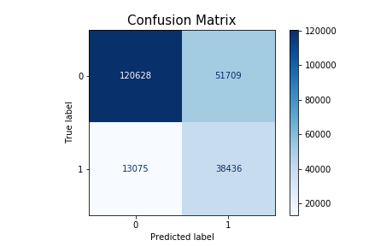
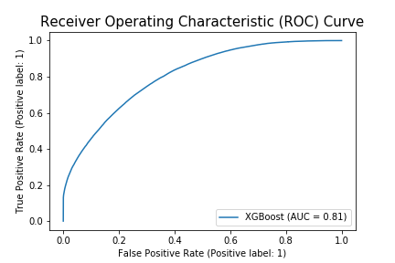
Hype Predictive Modelling
Business context
Hype Predictive Modelling or Hyper Personalization are a combination of predictive modelling projects. These projects will help to identify participants as per the mentioned scenario/use-case and further will help to automate targeted messaging and campaigns to the identified participants.
Requirements
To understand the business requirement, prepare and gather data and run different ML models on the prepared data as per the use-case and find best optimal model. and make the model deployment ready.
Use-Case Completed
To predict who is likely to take Leave of Absence (LOA)
To predict who is likely to go on STD (Short Term Disability) leave.
To predict new hire who are not contributing to Health Savings Account (HSA).
Impact
Using the final model, new prediction can be performed which can probably help in identifying participants for targeted messaging and campaigns based on the use-case.

Slide 2
Leave of Absence
Business context
Leave of Absence (LOA) is a period of time when the employee is away from the job., while maintaining the employment with the employer and can be paid or unpaid leave. There are multiple categories of LOA leaves that relates to Health and Welfare Plan. Government has also set up some rules and regulations for each type of LOA. Hence predicting who are likely to take LOA in next few months will help the organization proactively communicate the Health and Welfare plans to them. Alight provide comprehensive benefit package to support health, wealth and wellbeing.
Requirements
Data Gathering and cleaning, identifying important features for ML Modelling.
Running different ML models and identifying the best suitable model for LOA.
Making the model deployment ready.
Solution Provided
The data was cleaned and transformed, after running different ML models, best model was identified based on F1 score which came to be XGBoost. Further hyperparameter tuning was performed to improve F1 score, and final model is saved in s3 which can directly be used for predicting new dataset.
Impact
Using the final model, new prediction can be performed which can probably help in identifying who is likely to take LOA and organization can take further steps to engage with them and ask them to take the medical benefits.

Slide 3
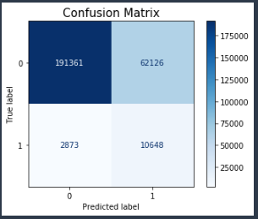
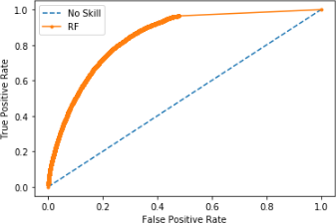
Short Term Disability
Business Context
STD is a type of LOA (Leave of Absence), STD plans enables the insurance provider pay a percentage of the salary if a participants become temporarily disabled. This could be due to illness, injury or pregnancy. It can be taken from 5 to 180 days. Once STD ends and employee is still not back then LTD (Long Term Disability) begins. Hence predicting who are likely to take STD in next few months will help the organization proactively communicate the Health and Welfare plans to them. Alight provide comprehensive benefit package to support health, wealth and wellbeing.
Requirements
Data Gathering and cleaning, identifying important features for ML Modelling.
Running different ML models and identifying the best suitable model for STD.
Making the model deployment ready.
Solution Provided
The data was cleaned and transformed, after running different ML models, best model was identified based on F1 score which came to be Random Forest Classifier. Further hyperparameter tuning was performed to improve F1 score, and final model is saved in s3 which can directly be used for predicting new dataset.
Impact
Using the final model, new prediction can be performed which can probably help in identifying who is likely to take STD and organization can take further steps to engage with them and ask them to take the medical benefits.

Slide 4
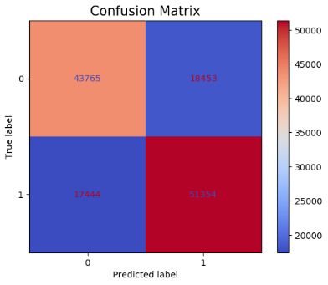
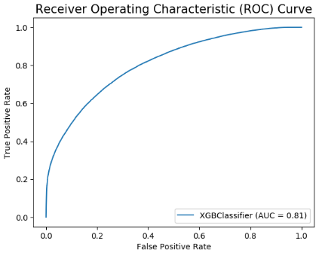
New Hire contribution to Health Savings Account
Business Context
A Health Savings Account (HSA) is a special bank account provided when somebody enroll in Bronze, Bronze Plus or Silver coverage level. It is a tax-free savings account. The aim of the project is to predict which new hires are likely to enroll in HDHP but are not likely to open and contribute to the HSA within 30 days. The prediction will help to identify participants who are not contributing to Health Savings Account and hence will help in taking appropriate action to ensure new hires who enroll in HDHP will also open and contribute to Health Savings Account.
Requirements
Creating SQL to gather data for ML modelling
Cleaning and transforming data, identifying important features for ML modelling.
Running different ML models and identifying the best suitable model
Making the model deployment ready.
Solution Provided
The data was cleaned and transformed, after running different ML models, best model was identified based on F1 score which came to be XGBoost. Further hyperparameter tuning was performed to improve F1 score, and final model is saved in s3 which can directly be used for predicting new dataset.
Impact
Using the final model, new prediction can be performed which can probably help in identifying new hires who are not contributing to Health Savings Accounts. Thus, helping organization to take further steps to engage with them and let them know the benefits of contributing.

